Slide 1



Decarbonising transport – buckle up!
Glenn Lyons
Mott MacDonald Professor of Future Mobility,
UWE Bristol
Glenn.Lyons@uwe.ac.uk / Glenn.Lyons@mottmac.com
https://www.linkedin.com/in/glenn-lyons/

Slide 2
Temperature in the room

Slide 3
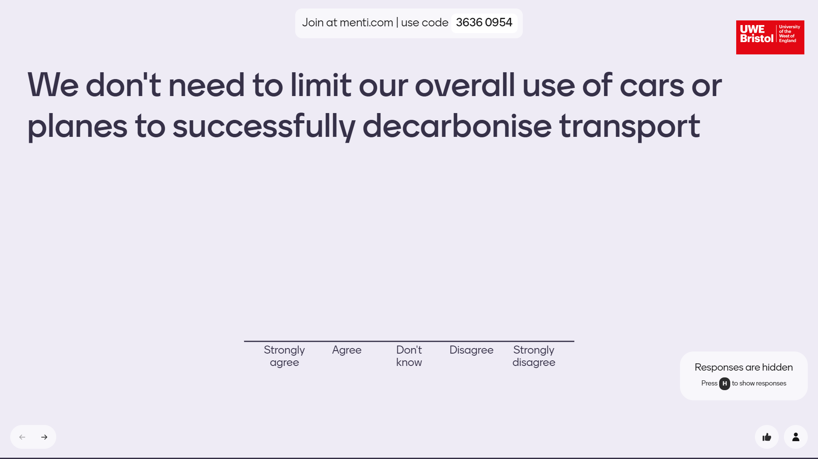
It’s anonymous

Slide 4
Shock and awe

Slide 5
The task is huge, the mission is critical
“To keep the 1.5-degree limit agreed in Paris within reach, we need to cut global emissions
by 45 percent this decade” (below 2010 levels)
“at 2 degrees, we start getting into scenarios that make most dystopian horror movies look like children’s colouring books”
https://www.climaterealityproject.org/blog/why-15-degrees-danger-line-global-warming
UN Secretary General, 4 April 2022

Slide 6
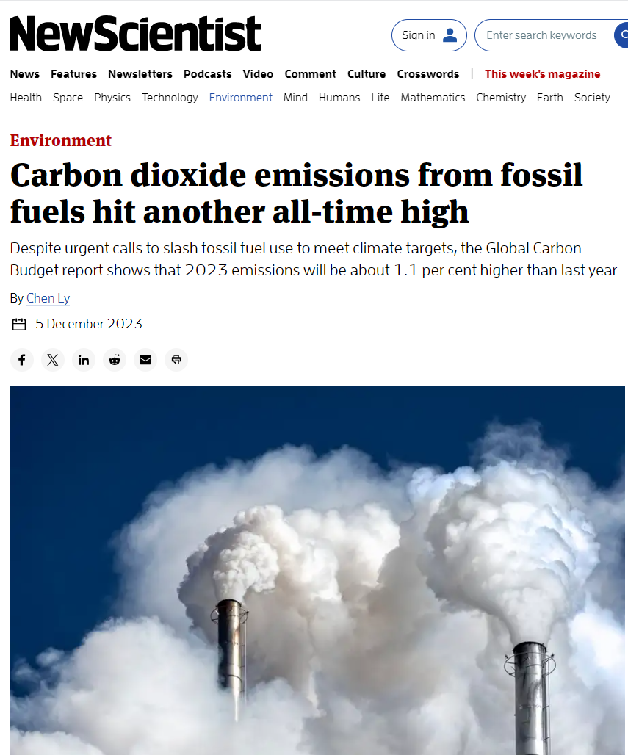
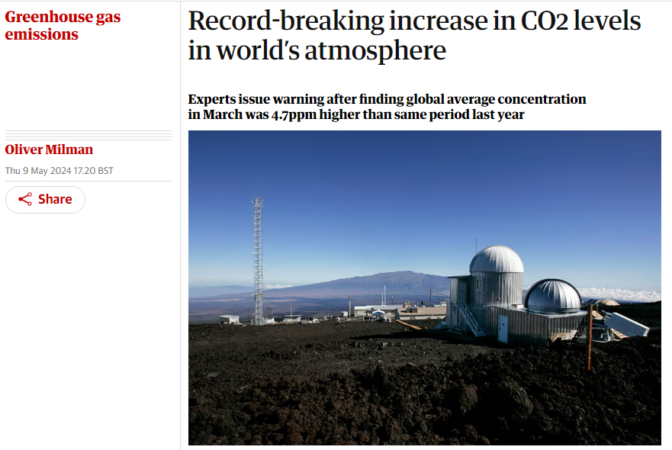
Is my microphone on, can anyone hear me?
December 2023
May 2024

Slide 7
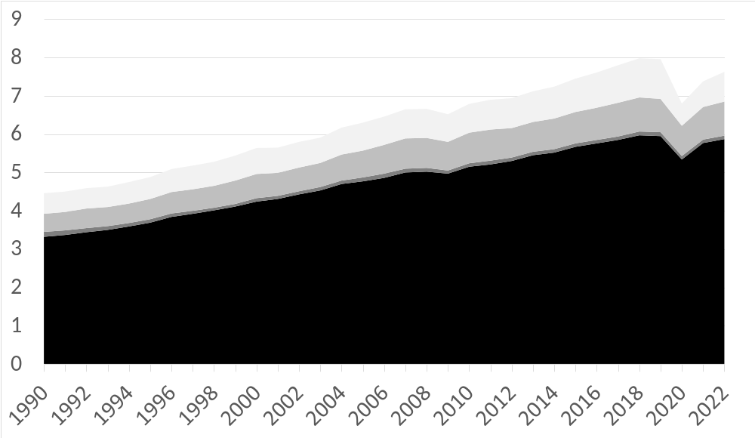
Let’s just worry about transport and its direct emissions
Aviation
Shipping
Transport accounts for around one-fifth of global CO2 emissions
Rail
Billion tonnes
55% of 2010
Road
Global CO2 emissions from transport 1990-2022
Sources
IEA (2023), Greenhouse Gas Emissions from Energy (https://www.iea.org/data-and-statistics/data-product/greenhouse-gas-emissions-from-energy).
Notes
Direct emissions from fossil fuel combustion for transport. Upstream emissions incurred during fossil fuel extraction and electricity generation are not included, and the combustion of biofuels is treated as non-emitting on a net basis.

Slide 8
World leading?

Slide 9
2022 UK greenhouse gas emissions (final figures)
by mode of transport (millions of tonnes)
40%
13%
13%
2%
% - share of total
1%
3%
1%
Car driving and flying are the big ones
5%
19%
4%
Notes:
Other domestic transport:
Military aviation
Military shipping
Aircraft support vehicles
Mobile air-conditioning - F-gases
Transport refrigeration - F-gases
Lubricant use in engines
Urea use in transport
Refrigerated transport machinery
Seaport machinery

Slide 10
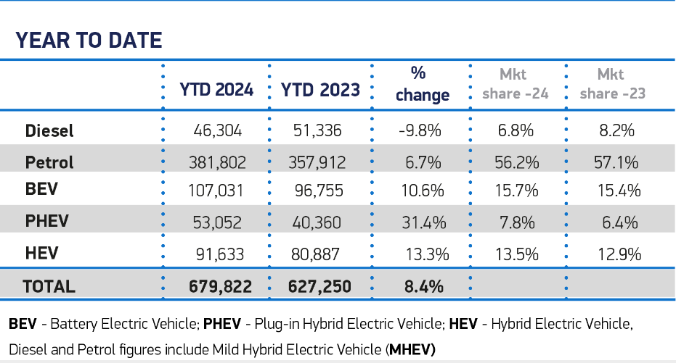


For overall car fleet we are in the early adopter phase for BEVs
“As of the end of April 2024, there are over 1,100,000 fully electric cars on UK roads”
New car registrations in the UK
APRIL
Total licenced cars in the UK: 36 million
cars on the road
that are fully electric:
3%

Slide 11

Jet Zero – Net Zero NOT ZERO
Pre-COVID annual emissions (domestic + international): 38 MtCO2e/year
70% growth in passenger numbers assumed (2021-2050)
This would amount to 52 MtCO2e/year by 2050
Thanks to Jet Zero ‘high ambition scenario’, emissions could be ‘only’ 19 MtCO2e/year
Jet Zero Strategy leaves around half of the emissions compared to today
“Many of the technologies we need to achieve it are
at an early stage of development or commercialisation”
July 2022

Slide 12
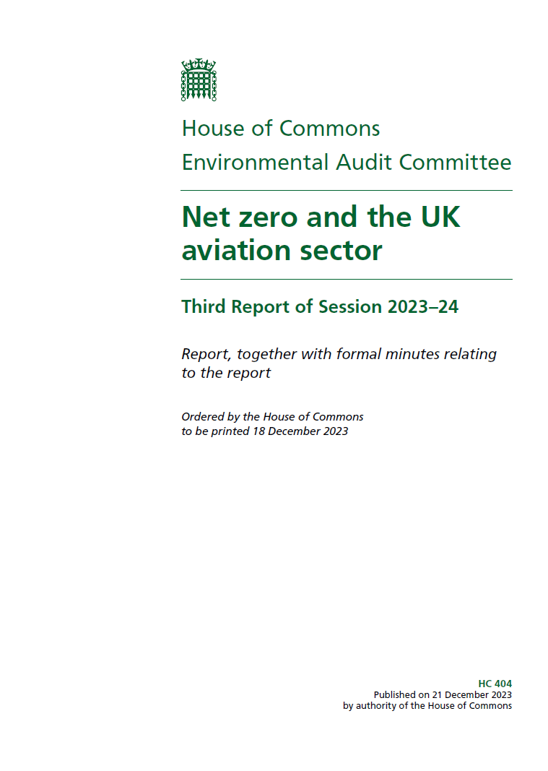
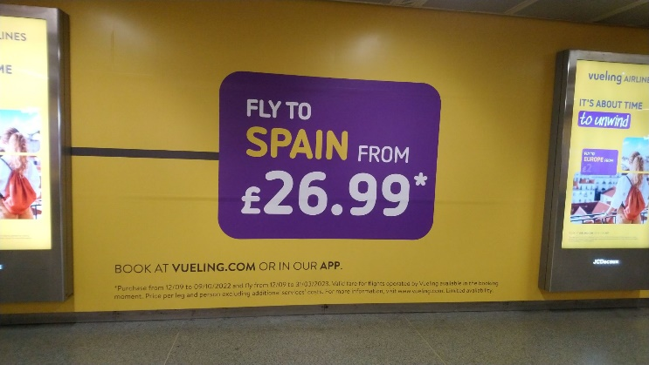
Initial review of Jet Zero recommended no later than end of 2025
“Should the evidence of the review indicate that technological measures alone will not deliver the emissions reductions predicted, we recommend that Ministers reconsider the role of demand management measures in aviation emissions policy. In preparation for the outcome of that review, we recommend that the Government develop policy proposals on demand reduction, including consideration of greater use of digital technologies, reducing the cost of rail travel, and a frequent flyer levy, should these then be required.”
December 2023
scrutinises the UK Government's performance on environmental protection and sustainable development
BAU

Slide 13



“this Progress Report reveals that, despite important achievements in renewable energy and electric vehicles, the Government is failing in much of its implementation”
June 2022
“Our confidence in the achievement of the UK’s 2030 target and the Fifth and Sixth Carbon Budgets has markedly declined from last year”
June 2023

Slide 14
Surface transport is UK’s highest emitting sector
“The Government has made no progress on our recommendations on clarifying the role for car demand reduction”
A Government choice not to quantify most policies aimed at incentivising modal shift signals a lack of commitment
Carbon savings from plug-in hybrid cars much poorer than previously thought, emphasising need to prioritise BEVs
“The market share of electric cars continues to increase ahead of our Balanced Pathway assumptions”
“Delivering the 2030 phase-out of new conventional car and van sales is vital to meeting the UK’s decarbonization pathway.”
June 2023

Slide 15

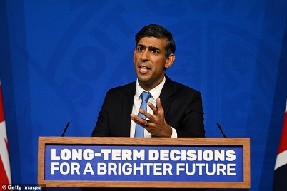
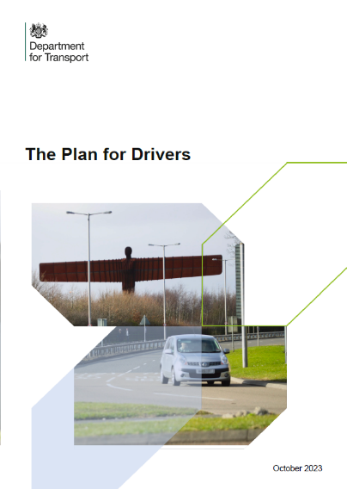
20 September 2023
can we put the
long-term interests of our country
before the short-term political
needs of the moment,
even if it means
being controversial?
So, to give us more time to prepare,
I’m announcing today that we’re going to
ease the transition to electric vehicles.
You’ll still be able to buy petrol and
diesel cars and vans until 2035.
You need a good opening line: "There's nothing wrong with driving."
2 October 2023

Slide 16
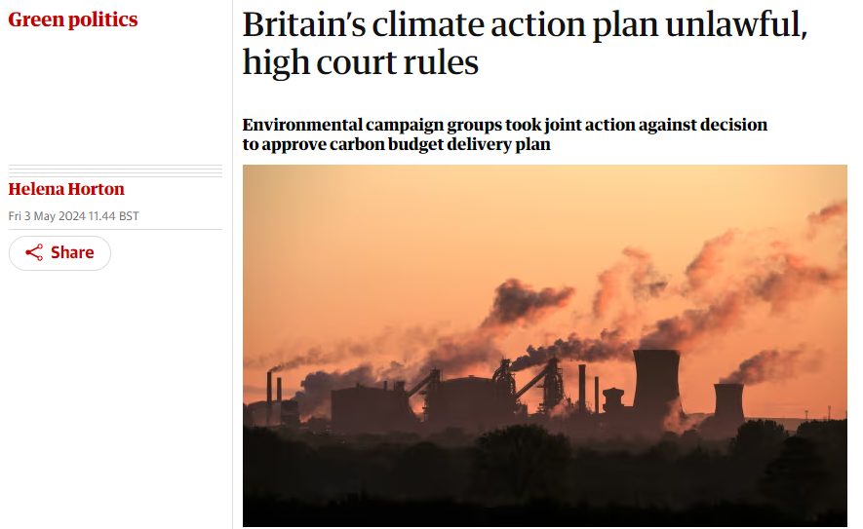
School detention, again
May 2024

Slide 17
Behaviour change
to the stage please!

Slide 18

Three levers at our disposal – use all three!
Avoid
Shift
Improve

Slide 19
How we approach decarbonisation of transport
In Theory
Avoid
Shift
Improve

Slide 20
How we approach decarbonisation of transport
In Practice
Improve
Shift
Avoid

Slide 21

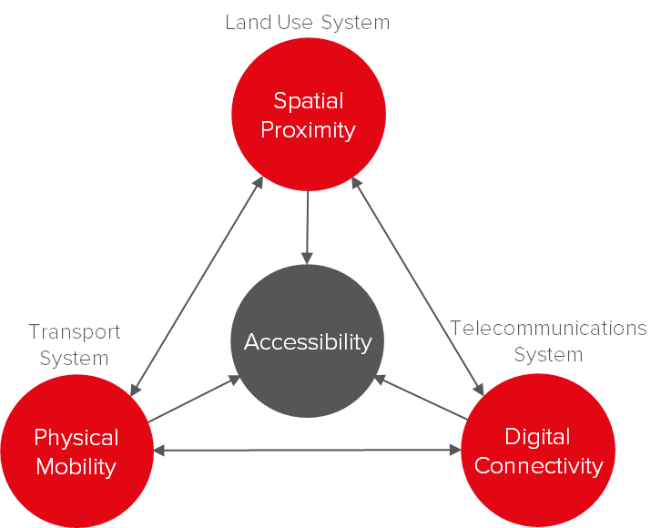

Changing behaviours in transport planning
March 2024

